Slide 1
A Guide to Loadpull
Loadpull and Match, inclusive Harmonic Loadpull.
Example: Panacea ZnO HighTxPower HearingAid.
SW tools used: QucsStudio4.2.2, Python3
Rowi ver.20211201

Slide 2
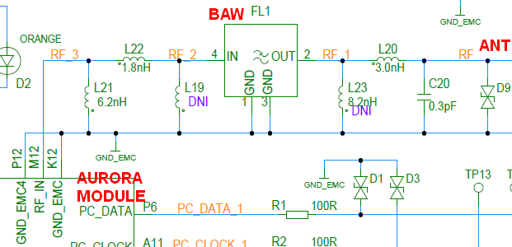
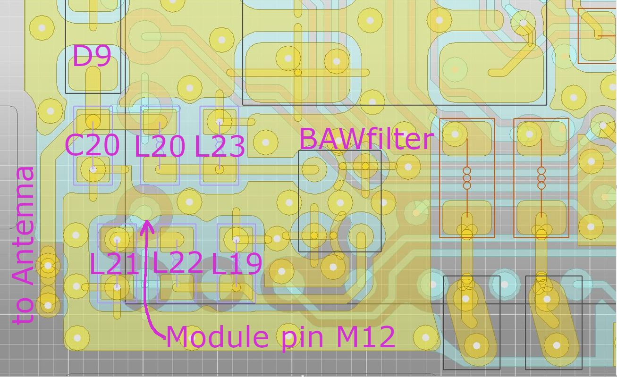
The Panacea DUT; its RF front-end circuit
Layer1
Layer 3
(there is ground in most of Layer2)
C and L are 01005 components
Size of displayed cutout of pcb is 2.5x4mm

Slide 3
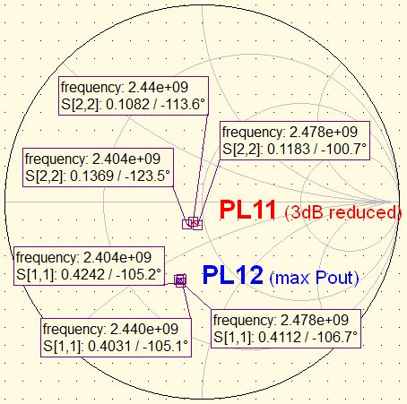
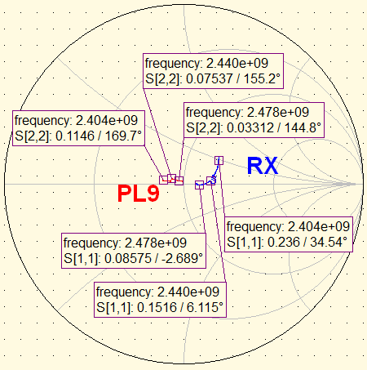
Module output Z, measured with NWA (R&S ZVB8)
A fast way to get an impression of the output impedance Z_out of a lowpower transmitter, is to measure its S22 with a network analyzer (NWA) during TX (Hot S-parameters). This is fine for making an initial match, but it cannot replace Loadpull, which gives knowledge about current consumption and nonlinear behaviour.
Measure Z_out in 2 tempi to get rid of the TX signal, with “continuous TX” transmitting first on 2420 and then on 2460MHz, then cut both S-parameter files in half at 2440 and paste together.
Use the following NWA settings (also do the calibration with the same settings):
P_out= 0dBm for TX measurement (lower will give more disturbance by TX signal, higher will overdrive the TX output)
BW=100Hz (1kHz will go very much faster, but gives more disturbance by TX signal)
P_out= -50dBm for RX measurement
Fundamental Z_out
Shown here is the measured Z_RF of the Aurora5CS4 module in 2Mbps mode, with reference plane at the pad of L22. It is done for different Tx-PowerLevels.
NB Pigtail phase deembedding with R&S ZVB is done with delay, thus broadband. Loss deembedding however is only valid at 2440MHz, thus a sweep to 4880MHz would show a wrong gamma.

Slide 4
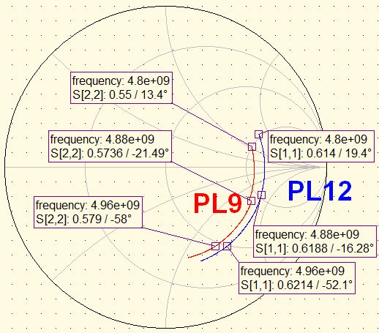
Match of Module output
The module has to be matched optimally to the BAW filter (which in our case is close to 50R). When looking at the previous page with the NWA measurements, one could be tempted to make a match with a conjugate of the PL12 Z_out.
This can be quite close if we are dealing with a PA where the nonlinear effects don’t have a big impact, but it will however not consider harmonics and current consumption, and we will not have an idea of how it will impact the lower PLs either. (Take a look at the contours further down in this presentation and find out what happens with harmonics and current!)
Also, it does not take into account which impedance we should present to the 2nd harmonic. Normally, the 2nd harmonic level can vary more than 10dB when the harmonic load is tuned (for a constant Fundamental load).
We could measure the Z_out at the 2nd harmonic (use the correct deembedding!) to get an idea of the optimal harmonic load, and avoid the ”max harmonics” spot where the load is close to the conjugate.
The measurement result is shown here, and when we compare with loadpull results on page21, it looks reasonable though not accurate.
But this result will not give an indication about the absolute harmonics level, and how many dB difference there is between any matching compromise.
The best approach is, to do both fundamental and harmonic loadpull of the module, make a match, then connect the BAW and do a fundamental loadpull, and tweak the match.
NB harmonic loadpull after the BAW is not useful, as its harmonic attenuation is so much that the harmonic load has no influence.
2nd harmonic Z_out

Slide 5
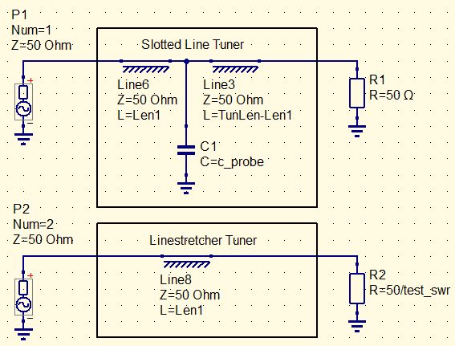
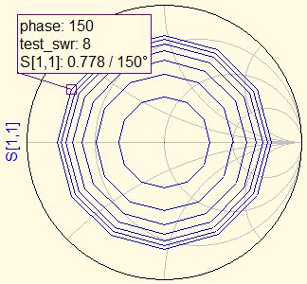
What is loadpull
Loadpull is the method of loading the DeviceUnderTest with a set of known load impedances (and/or source impedances).
A lot of measurement data is generated (e.g. Power, Gain, Efficiency, Noisefigure, Intermodulation), which can be analyzed in order to find the optimum impedance that the DUT has to look in to.
A practical approach is to step the SWR and rotate the phase. This can be accomplished with one of the following setups.
The Slotted Line Tuner is the most practical, as SWR can be varied while R1 is kept at 50R; in most cases a Powermeter or SpectrumAnalyzer is connected here.
The impedance presented to the DUT at P1 or P2 will cover the SmithChart like this, for an swept SWR of 1to8 step1, and phase 0to360 step30.

Slide 6
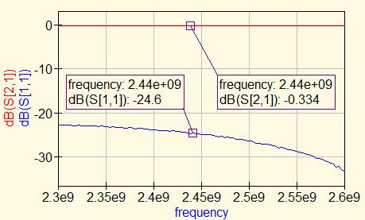
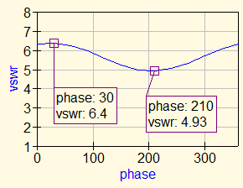
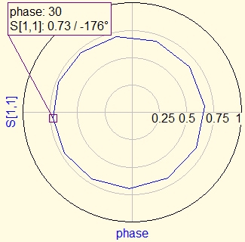
The importance of good cables / pcb traces
The following shows the characteristics of the pcb trace on the testboard that has been used to characterize the Aurora5 RF4 PA.
One should think that this has a decent performance, as e.g. a 24.6dB returnloss sounds quite OK.......
But, when we would use this board to loadpull the PA with swr=7 (gamma 0.75), the PA would see the following:
The swr is varying substantially over phase. The not-exact 50R line essentially offsets the center of the gamma circle.
The swr is always lower than 7, because the resistive loss (back and forth) reduces the radius of the circle.

Slide 7
Module optimal output Z, measured with Loadpull.
For transmitters that are not in a deep nonlinear mode, or transmitters that have some filtering in the output (which is valid for nearly all PAs with harmonics lower than -15dBC), output matching can be optimized separately for Fundamental and Harmonics.
This makes it a less imposible job, as we don’t have to test all combinations, so firstly we can do loadpull on the Fundamental while keeping harmonic load at 50Ohms, then keep the Fundamental impedance at the optimal spot while doing loadpull on the harmonics.
For our DUT, only the 2nd harmonic is causing problems, which makes it even easier.
Fundamental loadpull influences P_out, Current and Harmonics.
2nd harmonic loadpull influences only the level of the 2nd harmonic.
When doing fundamental loadpull, it is is problematic to just use a tuner directly at the transmitter output, because tuning the load impedance will vary the impedance of both the Fundamental and the Harmonics, unless a special setup is used. Some solutions are listed on the next page.
Loadpull in general:
Be careful! It will pay off to consider carefully how to do every step.
There are MANY ways you can make errors, e.g. by forgetting to change the marker frequency on the NWA, having the wrong offset etc.
Also use good cables with very low swr, and padding with attenuators, in order to avoid ripple over frequency in the complete setup. That makes life easier when calibrating at different frequencies.

Slide 8
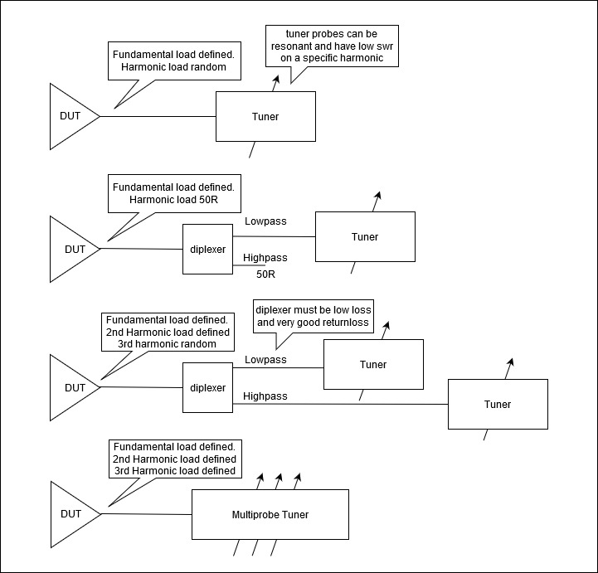
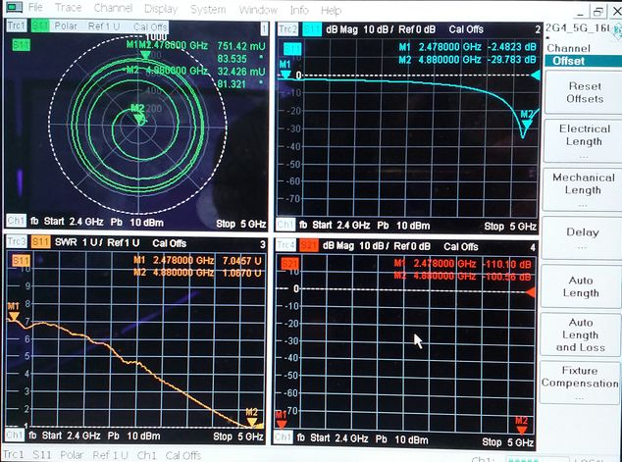
Commonly used Loadpull setups
Our Fundamental Loadpull setup:
① Fundamental= Maury 8045N directly.
② 2nd harm= When the hi-freq probe is fully out, the 2nd harmonic swr is < 1:1.2 over all phases:
Our Harmonic Loadpull setup, with diplexer:
① Fundamental= linestretcher, loaded with shorted variable attenuator.
② 2nd harm= Maury 8045N, hi-freq probe.

Slide 9
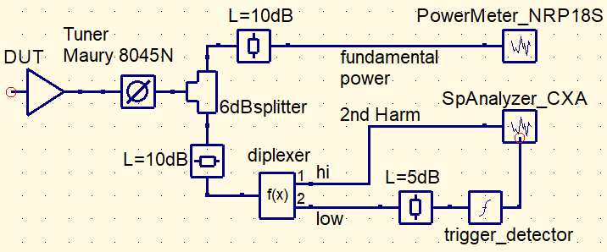
Fundamental Loadpull setup
① Fundamental= Maury 8045N directly. Make your own scale, and calibrate phase for each frequency.
② 2nd harm= For this tuner model, when the hi-freq probe is fully out, the 2nd harmonic vswr is < 1:1.2 over all phases. Super nice. (valid for the BLE band 2402-2480MHz)
During fundamental loadpull, we will measure Pout, Ibatt and Harmonics.
This setup is also used for DUT with built-in BAW filter, where the harmonics can be quite low. That is the reason for the following blocks in the setup:
Diplexer to remove the fundamental, in order to obtain sufficient Spectrum Analyser dynamic range.
Extern trigger for the Spectrum Analyser, to obtain easy triggering during weak signals.
Extra attenuator in front of the Power Meter, to reduce backwards harmonics generated by its detector.

Slide 10
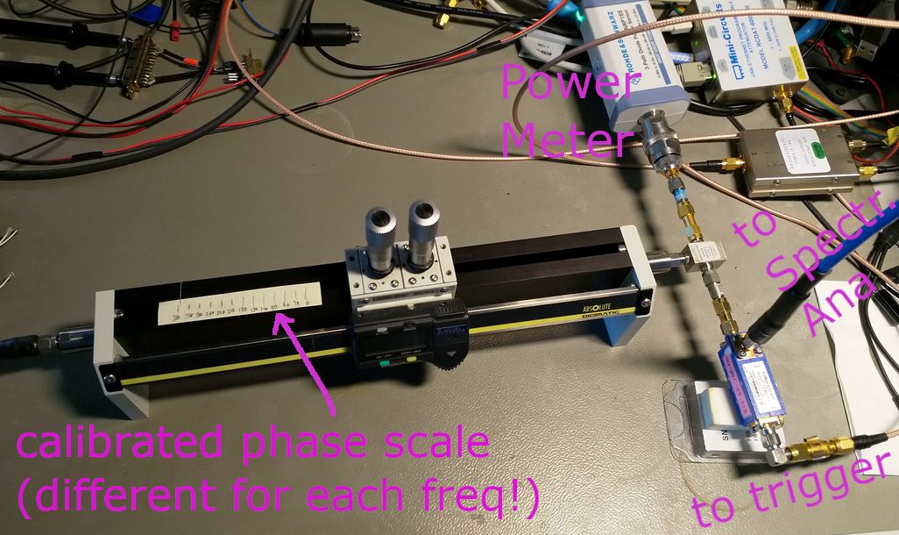
Fundamental Loadpull setup

Slide 11
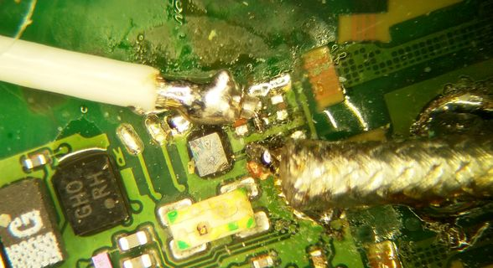
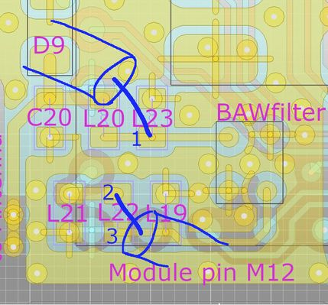
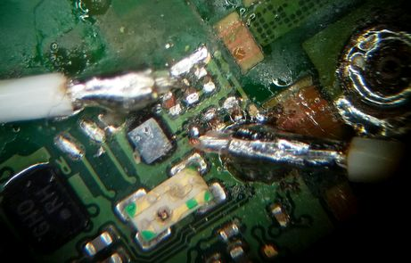
Reference planes
The deembedding reference planes of the example in this document are as follows (coax gnd is soldered at the very end of its shield):
NB if needed, the length of the inner conductor can be removed in simulation.
Loadpull:
1= BAW output (when the components L21 and L22 were still mounted)
2= module output
1
2
BAW s-par:
1= antenna side of BAW (port1)
3= (with coax connection moved from 2 to 3) module side of BAW (port2)
1
3

Slide 12
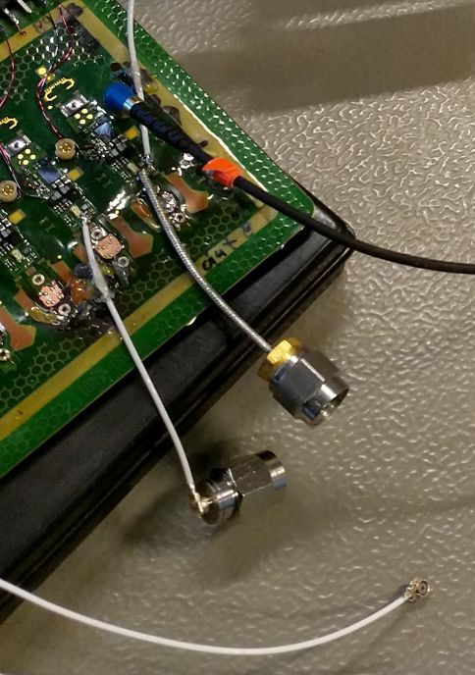
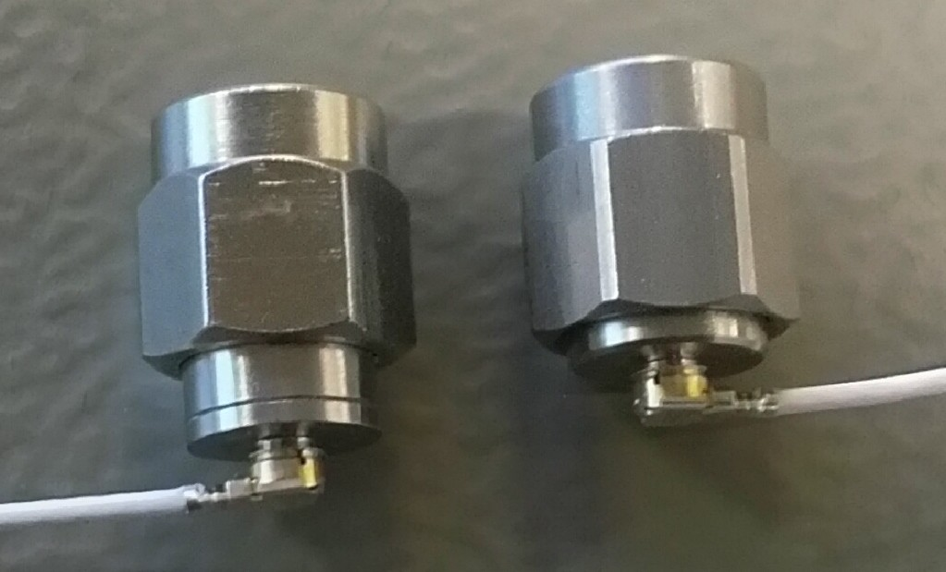
DUT pigtails
The most important parameters for the DUT pigtails are:
Very good 50R impedance.
Low loss (as short as practically usable).
Connector repeatability.
Both pigtails in the picture to the right, have proven to be useful. For swr of max 7, the thin white coax is preferrable ( because of its flexibility), as long as the little U.FL connector is not removed from the SMA adapter more than max a few times during the measurements.
Hirose cable assy PN: U.FL-LP-04N1T-A-[Length mm].
NB: notice that there are different versions of the UFL to SMA adapters! The two in this picture have 4ps difference in delay.

Slide 13
DUT pigtail length
Make a few accurately identical pigtails (NB 1mm error shifts your gamma with 9degr.) for the measurements, and carefully characterize the delay and loss.
NB The correct definition of length, is from SMA mating plane to coax solder point. But it is easiest for reproduction to just consequently define length from the edge of the connector head to the end of the shield; in this report I call the below pigtail “45mm”:
For loadpull measurements where good accuracy is a must, you can make shorter pigtails (I sometimes use 30mm), but too short makes it less practical in your setup, because of stress on the UFL connector or solder joint.

Slide 14
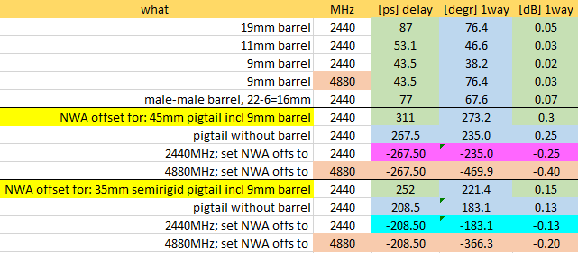
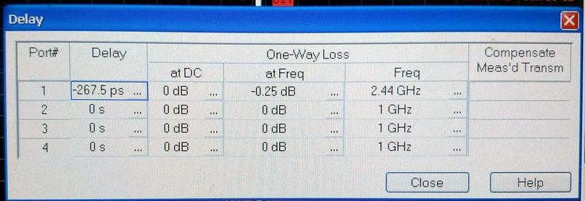
Deembedding for loadpull calibration
The deembedding delay and loss that is used for the pigtail, has to be ”inverted” when calibrating the tuner swr and phase.
As we want the tuner to give the wanted impedance at the DUT reference plane, we have to include deeembedding as negative loss and negative delay.
Usually the NWA has a measurement coax with male SMA connector as measurement port (because of Calibration Unit with female SMA connectors). The pigtail is then characterized with a SMA fem-fem ”barrel”. When connecting DUT to tuner, this barrel is removed and should thus not be included in the deembedding.
NB the offset loss on the R&S ZVB only works for the specified Freq; for harmonic it has to be changed manually.
NB the length of the barrel is measured between its mating planes.
NB the length of the pigtail is here defined as length of coax from connector head to end of shield (see previous page).
Offset on NWA R&S ZVB8

Slide 15
Measurement of harmonics
Harmonic level is measured with a SpectrumAnalyzer in zero span, and you have to consider your settings.
The measured level can differ a lot, depending on how it is measured, e.g RBW and Detector type.
Generally, the signal bandwidth is larger at the harmonics, because the signal can be spread out by e.g. a factor 2 for 2nd harmonic measurement, as harmonics are a nonlinear mechanism.
Most regulatory spurious specifications use 1MHz RBW above 1GHz:
Measuring with a RBW less than the signal BW, introduces AM in the resulting signal, which will give a higher pk to avg factor. Thus measuring with either pk or avg detector will make a big difference.
The following is measured on Panacea (module output) 2nd Harmonic of 2478MHz, 2Mbps BLE.
rbw 5 4 3 2 1 MHz
avg -14.4 -14.8 -15.1 -16.2 -19.4 dBm
pk -13.9 -14.2 -14.3 -14.8 -16.9 dBm
And as the most stringent regulatory limits are avg, it is most relevant to measure with 1MHz RBW and Avg detector:
Standard avg pk BW :2nd Harm limit [dBm]
Fcc -41.3 -21.3 1MHz (2nd harm falls in a restricted band)
Etsi -30 n.a. 1MHz
JRL n.a. -26 1MHz
MIIT -30 n.a. 1MHz
Average can be measured with the Keysight CXA in zerospan in ”marker band power” mode, which calculates rms in the selected time of the burst. That makes life easier when the harmonic signal is noisy or has high AM content.

Slide 16
Measurement of current/efficiency (Aurora5cs4 specific)
In the measurements referred to in this loadpull example, current is measured as the average current of the complete Hearing Aid at 1.4V supply voltage.
To be able to say something about efficiency, the current consumption of everything else than the PA has to be subtracted. In this way we get a figure for efficiency as experienced by the battery.
Transmission is 2Mbps BLE with 120Byte payload in DTM mode. The transmission pulse-length is 528usec, the repetition time 1250usec, which corresponds to a dutycycle of 0.422.
At this dutycycle, the current consumption of the PA of the HearingAid is the measured current minus the following value. This is the ”base” current consumption of the rest of the HearingAid, and is not dependent on Frequency. It was measured on 2 DUTs with an ”open-face” module where PA voltage is accessible:
PA Eff = 10^(Pout_dBm/10)/(Vbatt*(Ibatt_avg-Ibase_avg)) [I in mA]
This is the efficiency of the PA inclusive all its supply circuitry (fuel gauge, doubler, regulator).
PowerLevel setting:
PL is set in RAM by ”aucs_core.aurf_top.ifu_cluster.icy_trx_interface_noc.icy_trx_ip.config.pa_pwr”.
NB: when doing NWA measurement, ”continuous TX” is used, and there PL can only be set in NVRAM instead.
PowerLevel PL: | 12 | 11 | 9 | 0 | (with the same PA_bias (247) for all PL.)
avg basecurrent mA: | 4.13 | 4.08 | 4.05 | 4.02 | (to be subtracted from total avg current)

Slide 17
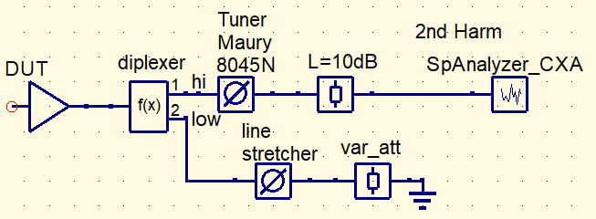
2nd Harmonic Loadpull setup
① Fundamental= set the impedance which is worstcase for the second harmonic. The swr is adjusted with the variable attenuator, which is shorted at the output, and the phase can be rotated with the linestretcher.
② 2nd harm= Maury 8045N via high-performance diplexer. The hi-freq probe is used. Make your own scale.
The diplexer must have very low return loss in order not to offset the gamma circle, and must have very low loss in order not to reduce the maximum swr. As there often will be some swr variation when tuner phase (probe x-position) is changed, you should adjust the swr (probe y-position) for each phase. Note the correct y-pos during calibration.
As this setup is only used for DUTs without BAW filter (harmonics are not pullable through the BAW filter because of its high harmonic attenuation), the harmonics will have such high level that external triggering is not needed.
As harmonic loadpull will have negligable effect on fundamental P_out, a solution without expensive tuner for setting the fundamental load can be used, as we don’t need an output. NB when Fundamental power has to be monitored anyway, a good coupler between diplexer and linestretcher could be used, but calibration will be problematic because of non-50R at both ends. (an alternative solution could be, to use a small low-inductance R instead of the short at the var_att output, and connect the powermeter to this point via a series 50R)

Slide 18
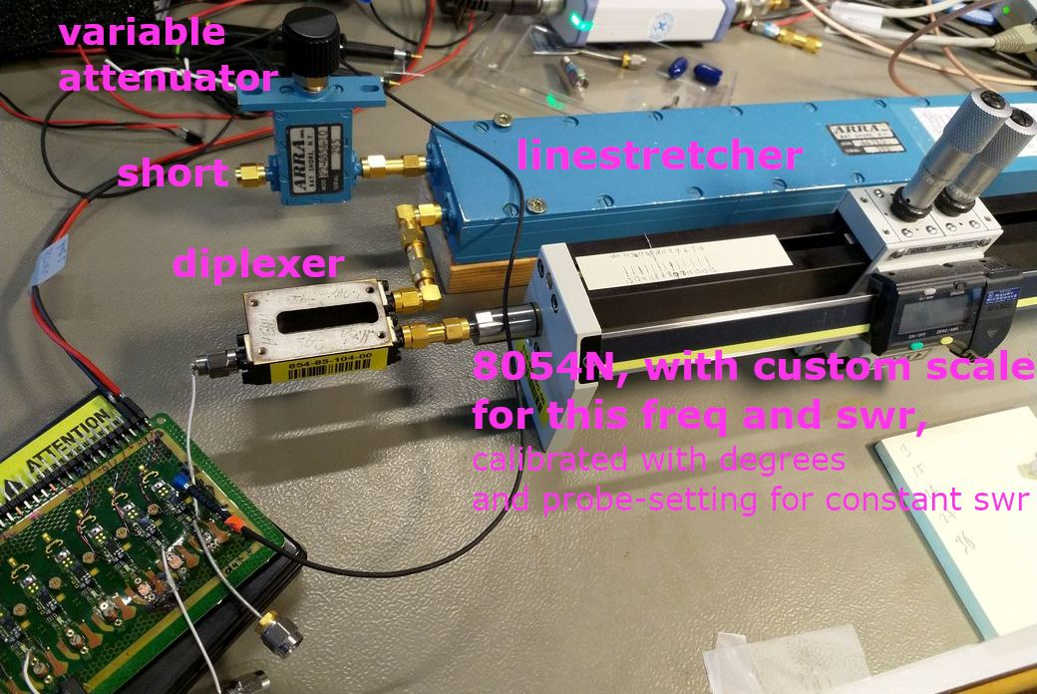
HiTxPow Module Loadpull setup
Adjust the probe-screw for each phase as noted during calibration, in order to keep the correct swr.

Slide 19
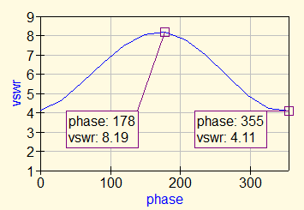
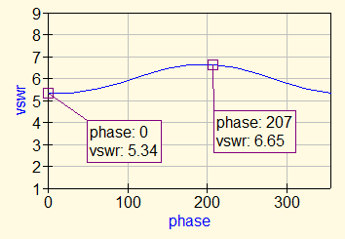
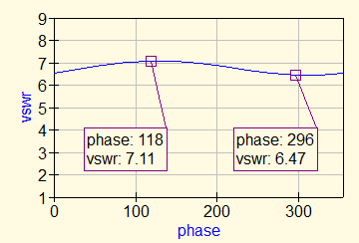
The importance of a good diplexer
When doing 2nd harmonic loadpull through a diplexer, its ReturnLoss shall be exceptionally good in order not to offset the gamma circle dramatically.
Here is the 4880MHz swr obtained at the DUT side through 3 different diplexers, with a swr=8 loadpull from 0 to 360 degrees on the highpass port:
Minicircuits Wainwright Custom design
ZDSS-3G4G-S+ WDK2400/3000-4800/12750-S3 (no vendor found yet)
ReturnLoss= 14.6dB RL= 25.6dB RL= 40dB
InsertionLoss= 0.58dB IL= 0.39dB IL= 0.2dB
StopBand= -50dB SB= -72dB SB= -30dB

Slide 20
Loss calibration
We have to use powergain, because we know the load impedance but not the source impedance.
Powergain from DUT to Powermeter (The DUT is looking into S11) =
$G=\frac{Pload}{Pin}=\frac{1}{1−\left|Γ1\right|2}$ |S21|² $\frac{1−\left|ΓL\right|2}{1−\left|ΓLS22\right|2}$ , where $Γ1=S11+\frac{ΓLS12S21}{1−ΓLS22}$ (S-parameters are from Pigtail + Tuner)
For a 50R Powermeter, where Γ_{L}=0 : Γ₁= S11, thus $G=\frac{\left|S21\right|2}{1−\left|S11\right|2}$ . In dB this is dB(S21) - mismatch loss.
In practice the situation is more complicated, as the mismatch doesn’t happen at the DUT port, but inside the tuner at the point where the probe is. There, Γ is higher than at the DUT.
① Fundamental loadpull: Normally, we keep the loss between DUT and Tuner as low as possible, so we can consider the mismatch to happen at the DUT port without a big error. Just measure the loss to Powermeter and Spectrum Analyzer during swr=1. Mismatch loss is just part of the loadpull and should not be compensated for.
② 2nd harm loadpull: this is more complex, because of the addition of the non-ideal diplexer.
Here the loss at high swr is generally higher than just the mismatch loss, and we should calculate the Γ at tuner probe and compensate for the extra loss from there to the DUT.
This is not implemented in the following measurements as we were mostly interested in relative behaviour over phase.

Slide 21
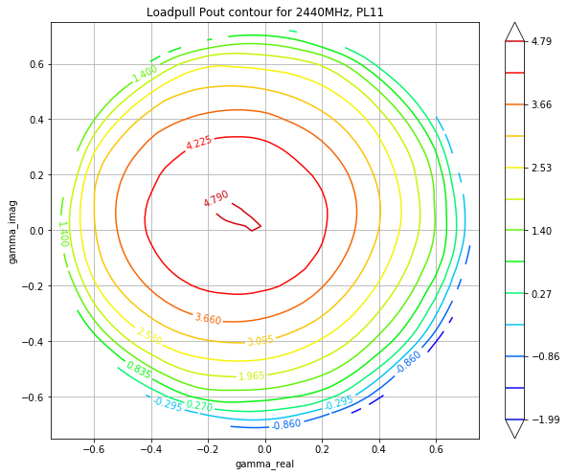
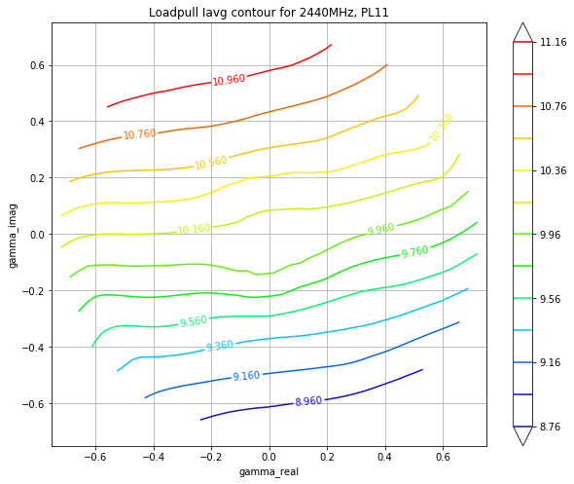
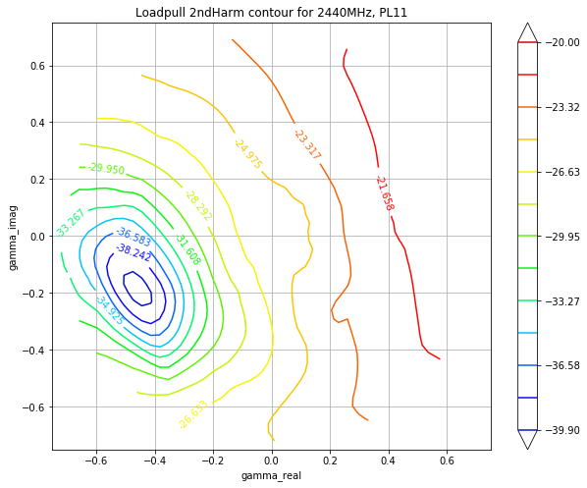
Example of Fundamental loadpull results
Here are some of the loadpull results of the Panacea DUT, at the module output, for Tx at PL11. Load impedance at the 2nd harmonic was kept at 50R. The results are plotted as contours. These contour plots are essentially a polar plot with the same shape as when plotted in a smithchart, and the center is a gamma of 0 which corresponds to 50R. It shows lines with constant values. From these contours we can conclude the following for PL11 (NB it is different for PL12):
P_out: max output is close to 50R.
I_avg: for a slightly inductive match, the power is reduced but current increased!! Capacitive load also reduces the power, but decreases current instead so this can be used when making a compromise.
2nd_harm: here a compromise for better harmonics is a smaller real value of the load impedance.

Slide 22
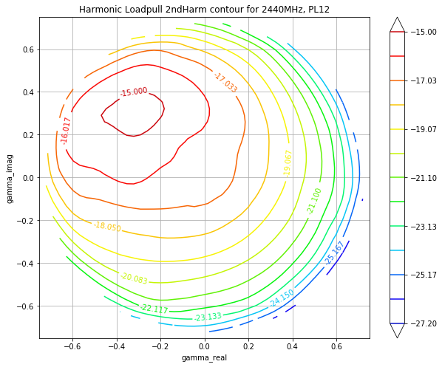
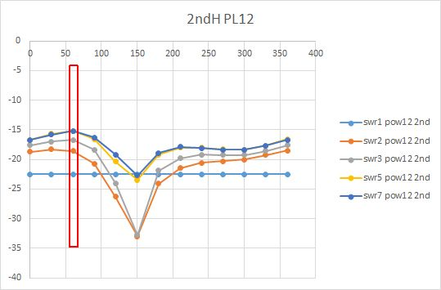
Example of Harmonic loadpull results
Here are some of the results of the Panacea DUT, at the module output, PL12, mid channel.
Fundamental Load impedance was kept at swr3/60degrees (which was the phase that was worstcase for the 2nd harmonic), while the 2nd harmonic was loadpulled .
As can be seen from the 2nd harmonic loadpull contours, the worstcase harmonic load impedance turns out to be only a few dB worse than the 50R point, but the 2nd harmonic can be reduced with nearly 10dB by only changing the harmonic load impedance! (while keeping the fundamental load unchanged)
Fundamental load

Slide 23
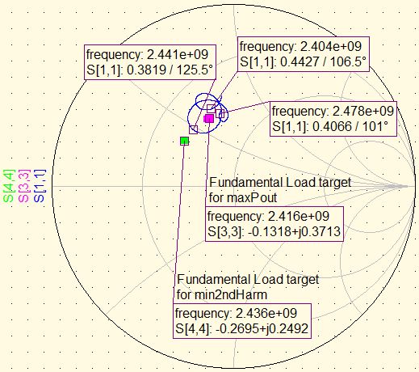
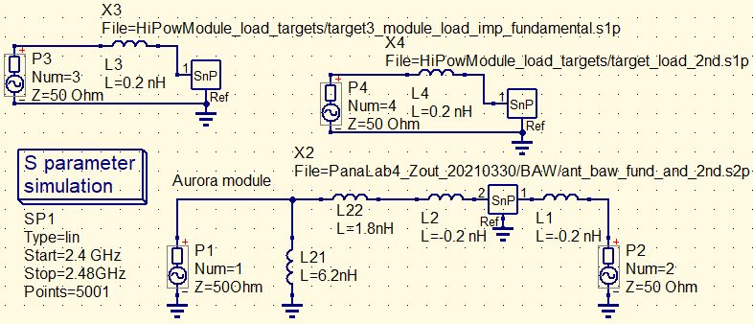
Example of matching to the best spot found with loadpull
If we want to make a match for maximum P_out at PL12, we can plot the target output load of the module into a smithchart, simulate the impedance seen by the module (with 50R load as antenna), and tune the match to hit the target as found by loadpull.
For this, we need an s-parameter measurement, of the circuit inclusive BAW filter between loadpull reference plane and the antenna reference plane. A small negative inductor has to be added on both sides to compensate for the ends of the measurement pigtails. A small positive inductor must be added to the targets accordingly.
In the Smithchart to the right, the magenta dot is loadpull-optimum for P_out.
In this match, L21 and L22 are tuned to hit the P_out target over the band.
If one would make a compromise to get lower 2nd harmonic, a series capacitor could be added between L21 and the module, or better consider the load at 2nd Harm instead.

Slide 24
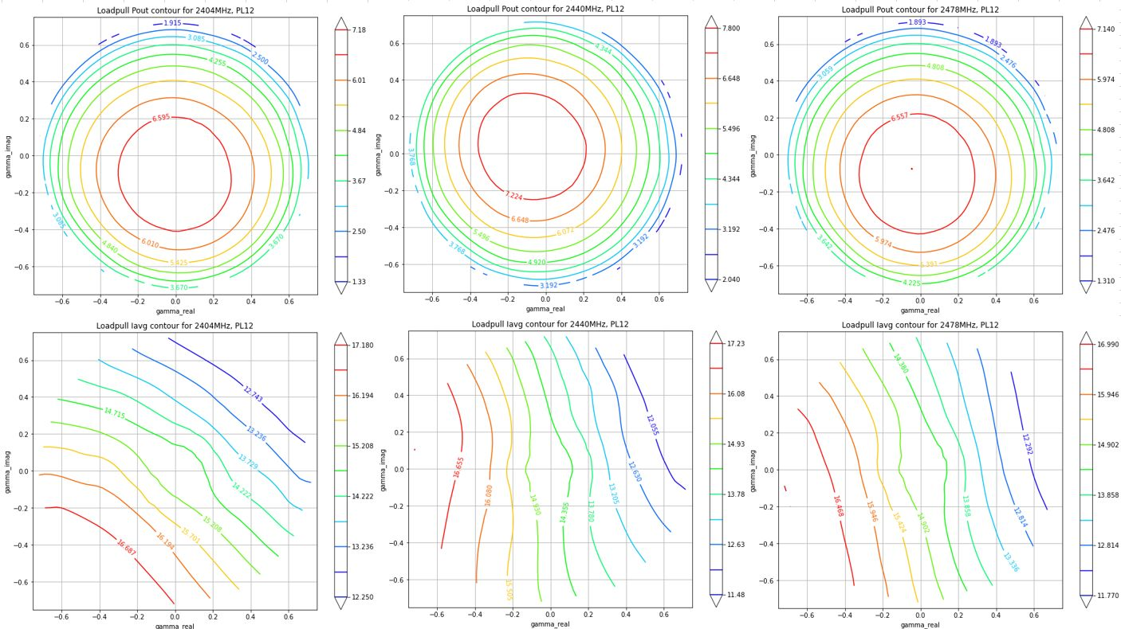
Check of the matching, by loadpull at antenna Ref.plane
After mounting the match and BAW filter, loadpull was done to check the performance. P_out is spot-on centered.

Slide 25
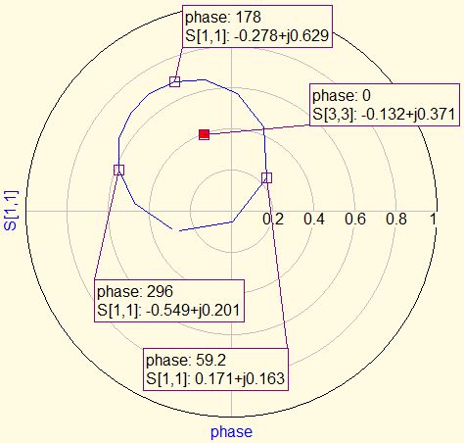
Module load when loadpulled at antenna port
To get an idea of which load impedance the module sees through BAW and match, when the impedance at the antenna reference plane has swr=3 at an arbitrary phase, the following loadpull can be simulated for a sweep of 0 to 360 degrees:
The red dot in the polar plot is the Module load target for max P_out at PL12, 2442MHz. It can be seen that some phases can move the load further away from the target than other phases. This knowledge can help to optimize the matching between physical antenna and antenna reference plane (L23, L20, C20).

Slide 26
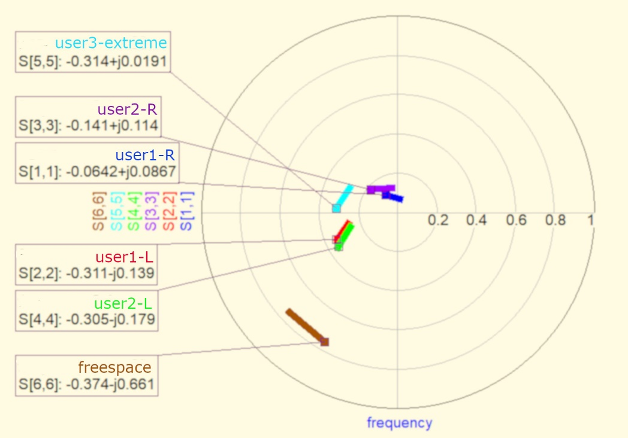
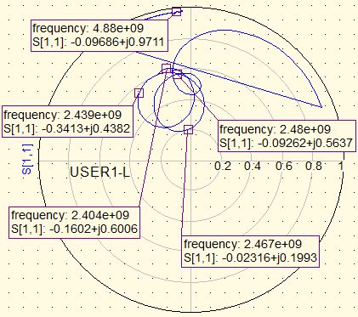
On- Ear Module load
The antenna impedance as the module sees it, is spread-out through BAW and match, and makes 2 turns over the band. ​
In the same way, the contours at the ant ref plane will be quite different over the band, and at that plane it is not sufficient to do loadpull at only low/mid/hi channel.​
The module load in the USER1-L case:
The antenna impedance, when the hearing aid is worn on the Left or Right ear, can spread a lot depending on people’s ears.
Panacea has the following antenna impedance as seen at the antenna reference plane (freq sweep is 2400-2480, with marker on 2400MHz):

Slide 27
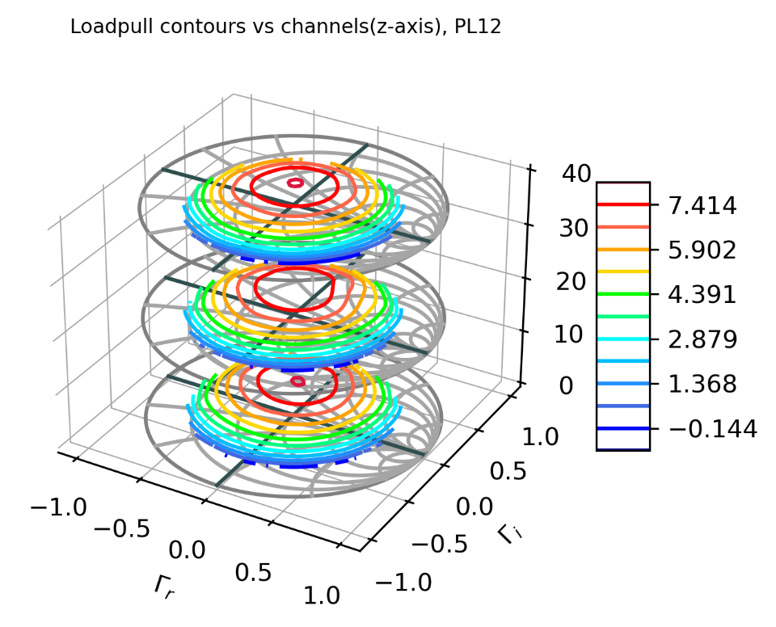
On-Ear Module load; optimizing the match
To optimize the match, for all possible antenna impedances and at all channels,
the best strategy is to do this at a reference plane closest to the PA.
Here the P_out contours hardly move over frequency.
Using this, we can simulate the antenna load seen at this point through BAW and match, and tune the match while showing the simulation result in the mid-channel contour. In this way we can have the full overview while tuning the match.
PL12 P_out loadpull contours at module output, shown in Smith-Tube where Z-axis is channel number:

Slide 28
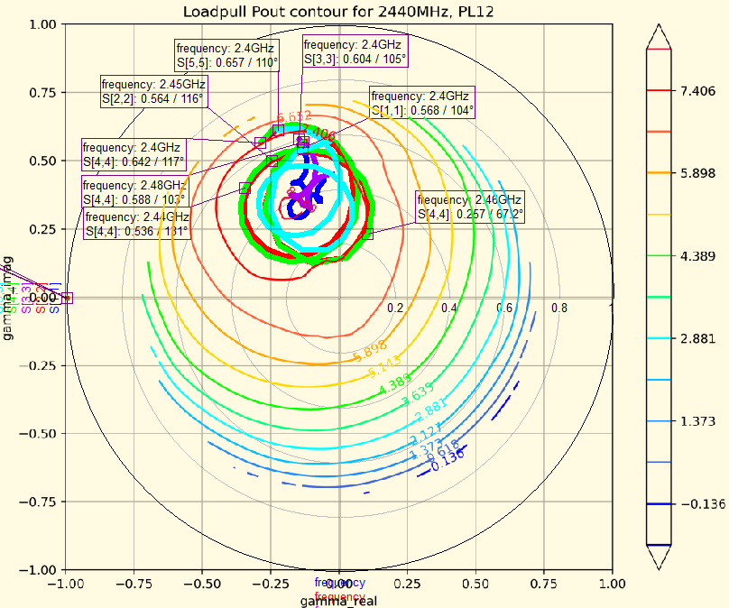
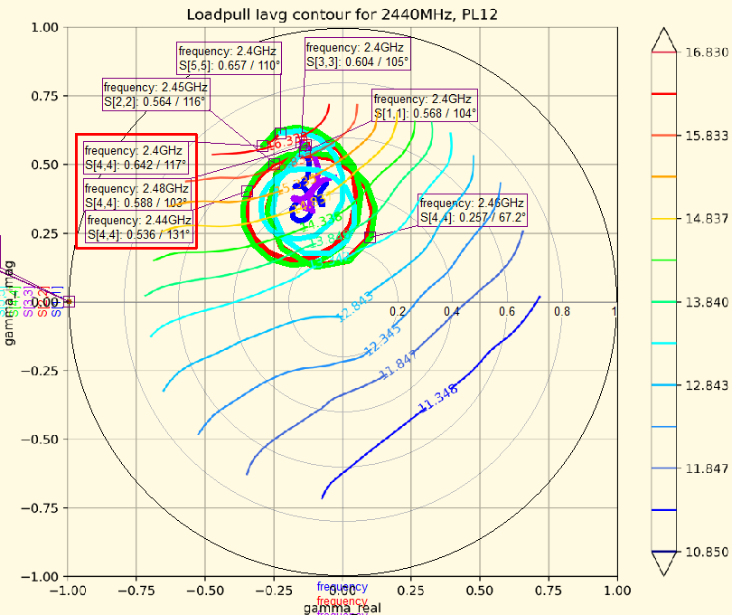
On-Ear Module load and contours
Here are all 6 Panacea antenna impedances as the module sees it (spread-out through BAW and match), plotted inside the Module contours. The match is tuned to get the impedance centered around max P_out, from 2.4 to 2.48GHz.
The current consumption will vary a lot over the band, and will in fact be relatively high at lowest and highest channel. Another match topology must be chosen if this is a problem for e.g. TypeApproval conditions!

Slide 29
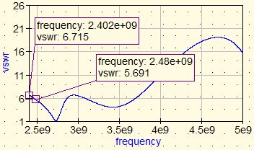
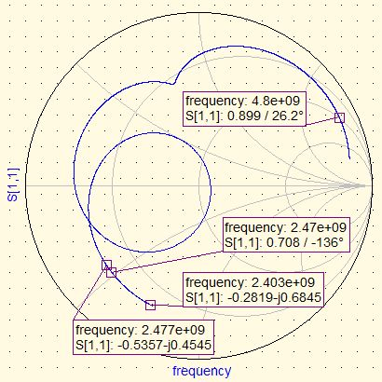
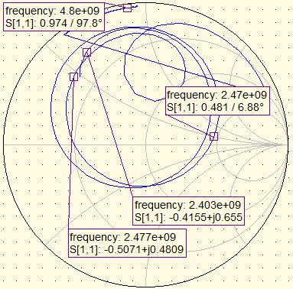
Freespace Module load
The module however, sees it through BAW and match, which spreads the impedance inside the band over a big area.
Harmonic impedance is not influenced by the antenna at all, because there is a lot of attenuation through the filter.
The Panacea antenna in free space has a relative high swr, which is a good thing (low P_out) for complying with e.g. Fcc radiated requirements, because radiated requirements are measured in FreeSpace.

Slide 30
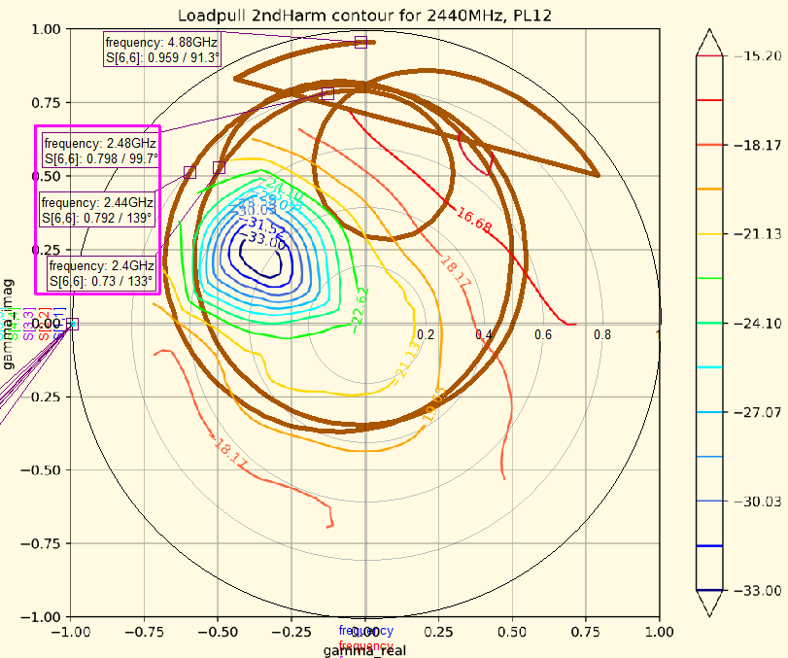
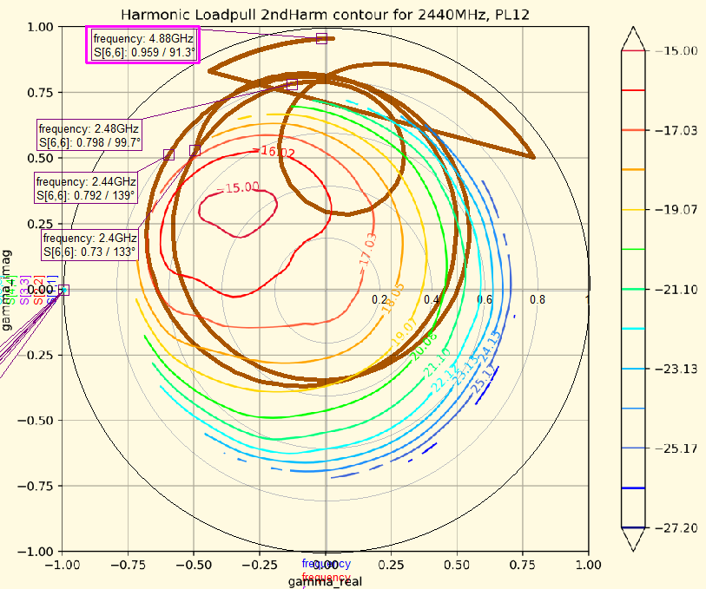
Freespace Module load and contours
Because of fundamental impedance, the Freespace 2nd harmonic will vary a lot over the band, and will in fact be relatively high at highest channel. Another match topology must be chosen if this is a problem!
Fortunately the module load at the 2nd harmonic frequency (thus here shown in the contour from the harmonic loadpull) has a gamma close to 1, which helps here.

Slide 31
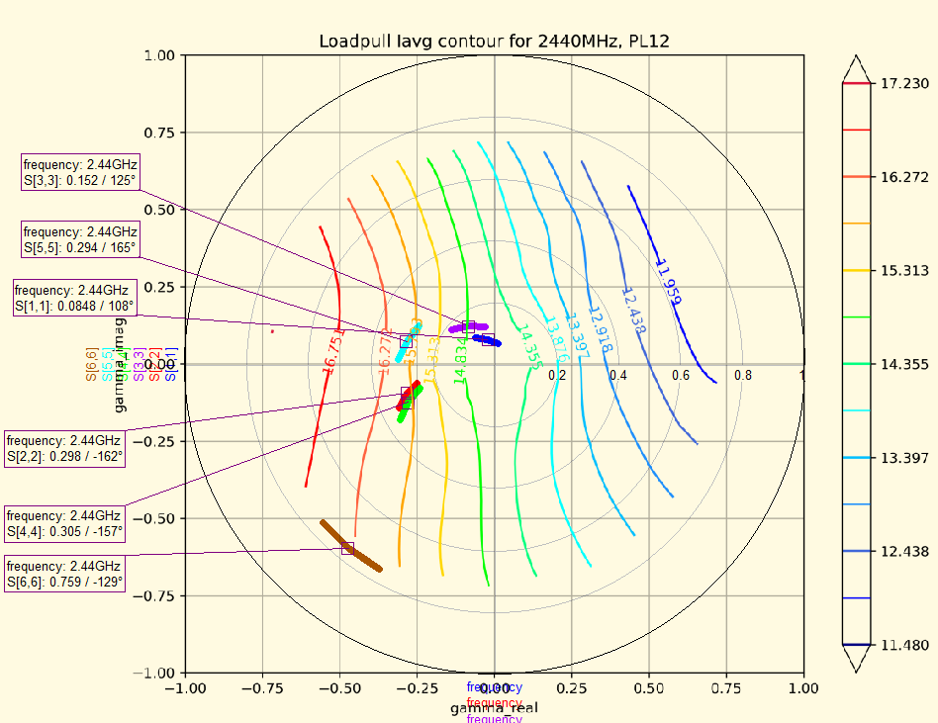
Antenna impedance and current consumption
Plotting the antenna impedance in the I_average contours as measured at the antenna reference plane (after the BAW filter but before the antenna match components L23, L20, C20) , shows that the antenna impedance could use some tweaking if we want to improve current consumption.
Moving the antenna impedance to a higher real value can give the same output power but lower battery current.

Slide 32
Bonus material
In this folder, the following can be also found:
QucsStudio project (see also next page) and a ”user notes” document.
Python3 code for generating contours from loadpull data.
More material will be added later.
To be continued…

Slide 33
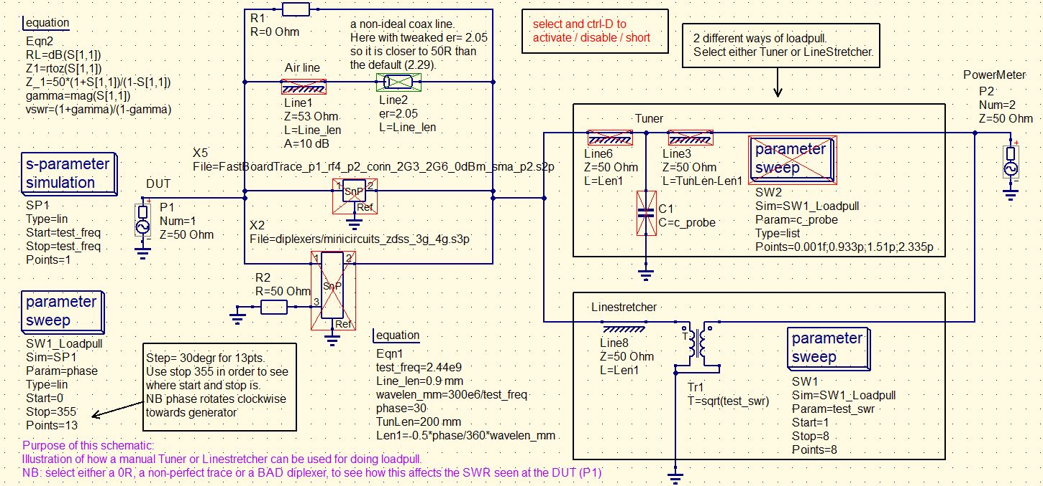
RF toolbox with QucsStudio
The project ”sparameter[yyyymmdd]_studio_proj” contains some simple simulation benches that can be used to get familiar with many of the things discussed in this presentation.

Slide 34
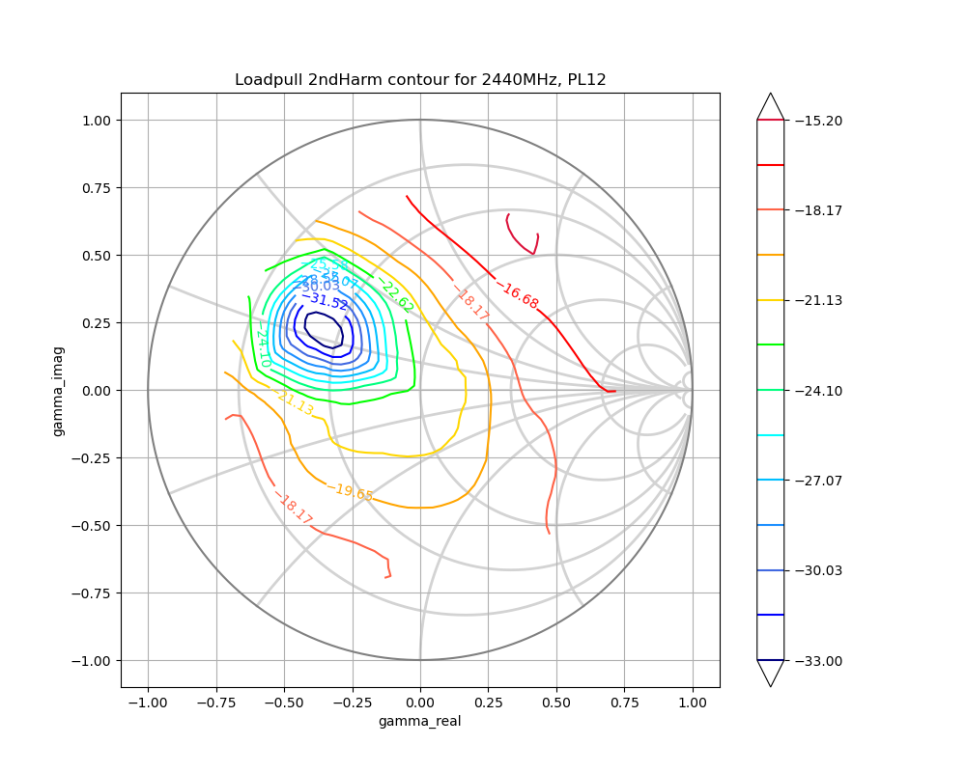
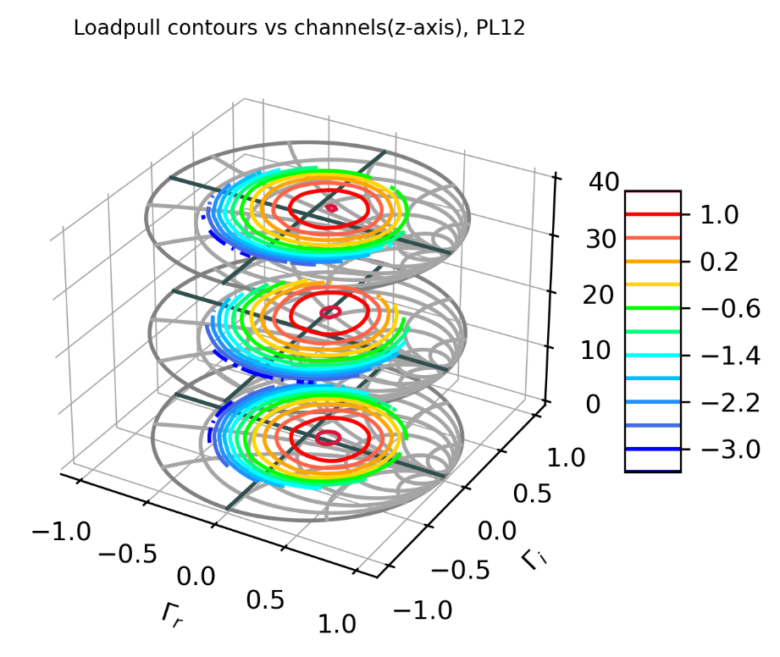
Use of Python for plotting of loadpull data
Two Python scripts are available at the moment for plotting;
Contours, with or without Smithchart/Polarchart: Smith-Tube contours with frequency Z-axis:

Slide 35
Alternative Smith Tube etc. for 3D plotting of loadpull data with Python
https://www.microwaves101.com/encyclopedias/de-embedding-load-pull-data
4 Ways to boost Simulation Data Processing Using Python:
https://www.keysight.com/main/eventDetail.jspx?cc=DK&lc=dan&ckey=2791771&nid=-34335.804578.08&id=2791771
slides : \\strnt6.emea.demant.com\common\kbn_rowi\loadpull_pana_lab4\spar_docs
https://community.keysight.com/community/keysight-blogs/eesof-eda/blog/2017/04/11/generating-3d-smith-charts-the-easy-way
3D smithchart (smith tube) : http://www.keysight.com/find/eesof-3dsmithchart
https://community.keysight.com/community/keysight-blogs/eesof-eda/blog/authors/kaelly_farnham
→
For Help Designing a Broadband PA, 5 Reasons to Try a 3D Smith Chart
https://edadocs.software.keysight.com/display/eesofkcads/ADS+Python+Data+Link+Basics
Polar plot:
http://devdoc.net/python/matplotlib-2.0.0/examples/pylab_examples/polar_demo.html

Slide 36
Deeembedding
HP_AN1364-1_deembedding_5980-2784EN
\\strnt6.emea.demant.com\common\kbn_rowi\loadpull_pana_lab4\spar_docs

